Slide 1
Shelf life vs. Order Quantity: A Discovery Analysis
Will Shelley

Slide 2
What are we doing?
Determining the effect that remaining days of code has on the order quantity of Locations
Using a multiple regression analysis to see if remaining days left has an effect and by how much
Purpose: Information discovery and possible business adjustments

Slide 3
Panel Data – Fixed Effects Regression
Cross-Sectional – Multiple subjects sampled at one time (snap-shot)
Time Series - Single subject sampled across time
Panel (Longitudinal) data – Multiple subjects across time
Fixed vs. Random vs. Pooled OLS
Why is Fixed Effects Regression important?
It allows for measuring variation amongst subjects rather than lumping all subjects together
Allows for unmeasurable variables (i.e. preferences) to be accounted for
Group Identifier – Location_UPC combination

Slide 4
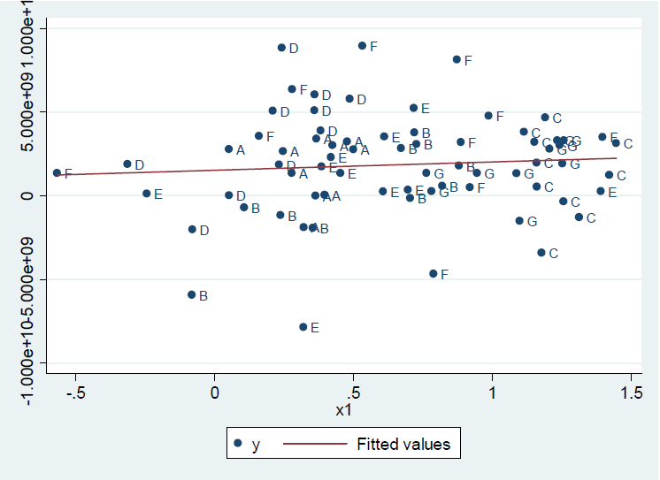
Pooled OLS

Slide 5
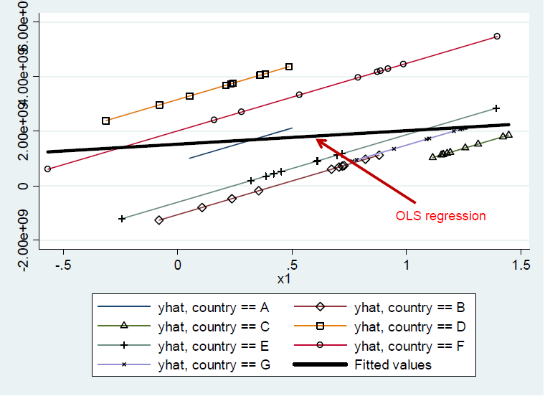
Panel Data – Fixed Effects

Slide 6
Assumptions of the Analysis
Order data and Retail Sales data
Looking at 25 (26 minus 1) weeks of data (FY 2017 FW27-52)
Exclude seasonal product

Slide 7
Variables
Name | Description
order_plus1 | Number of cases ordered the next order of a UPC by Location (t+1)
daysleft | Remaining days of shelf life on the product when it was shipped
cases_sold | Retail sales record of the UPC for that FW by DC
casesordered | This weeks cases ordered
shelf_life | Total days of shelf life of the product
store_count | Distinct count of stores in a Location
true_multi | Observed that a distributor had multiple Locations
cakes_per_case | The number of cakes in each case

Slide 8
Interpretation of Model
Model | Dependent or Response Variable (y) | Independent or Explanatory Variable (x) | Interpretation of m Given a change in x, how much do we expect y to change by?
Level-level Regression y = mx + b | y | x | Δy=mΔx “If you change x by one, we’d expect y to change by m"

Slide 9
The Model
order_plus1 = m₁ daysleft + m₂ casesordered + m₃ cases_sold + intercept + error
Interpretation:
As the independent variable changes by 1 unit, Next weeks order changes by the coefficient (m)
Example:
Order_plus1 = 0.025 daysleft :
➔ “As remaining days left goes up by one day, Next weeks order goes up by 0.025 cases”
or
Order_plus1 = -0.033 daysleft :
➔ “As remaining days left goes up by one day, Next weeks order goes down by 0.033 cases”

Slide 10
Check for Understanding
Questions?

Slide 11
Summary : All Brands
7,955,114 observations
474,379 groups (location_upc combinations)
Quartile | Days left range | Cases Ordered Range
1 | 15-117 | 1
2 | 15-117 | 2
3 | 14-117 | 3-5
4 | 16-117 | 6-951
Summary Stats of Data
Var. | Min | Max | Avg.
Shelf life | 30 | 120 | 45
Days left | 14 | 117 | 38
Cases Ord. | 1 | 951 | 4.3
Cakes per Case | 12 | 240 | 114

Slide 12
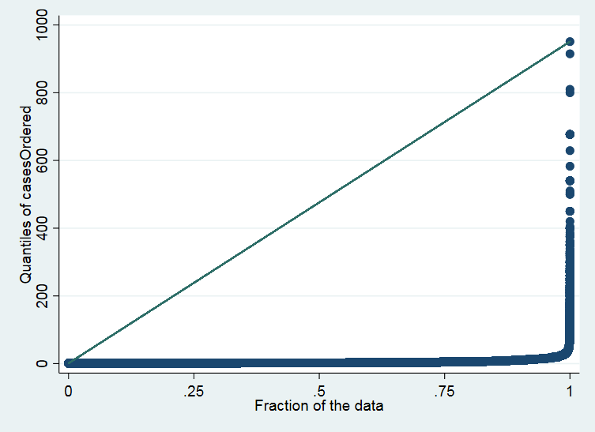
Summary : All Brands

Slide 13
Results : All Brands
7,955,114 observations
474,379 groups (location_upc combinations)
Variable | Coefficient | Std. Error | Adj. R² | Min Weekly Lift One Day | Expected Weekly Lift One Day | Max Weekly Lift One Day
Daysleft | .0049643 | .0006226 | 0.7964 | 4,261 | 6,831 | 9,400

Slide 14
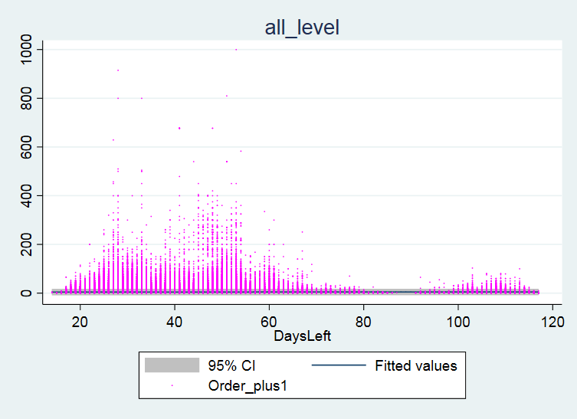
Results : All Brands

Slide 15
Summary : All Brands

Slide 16
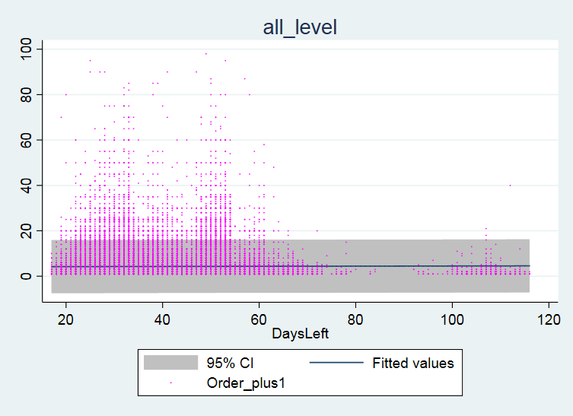
Results : All Brands

Slide 17
Panel Data – Fixed Effects

Slide 18
Summary of Pooled OLS Estimates
Model | Variable | Coefficient | P-value
Pooled OLS | daysleft | .0218088 | 0.000
 | casesordered | .776454 | 0.000
 | shelf_life | -.0170025 | 0.000
 | store_count | .0005929 | 0.000
 | true_multi | -.0132046 | 0.000
 | cases_sold | .000015 | 0.000
Adj. R² | cakes_per_case | .0015049 | 0.000
0.7122 | _cons | .0279827 | 0.067

Slide 19
Summary of Brand Dummy Variables
Model | Variable | Coefficient | P-value
Pooled OLS | ldfp | .1181088 | 0.000
 | ldbp | .2325526 | 0.000
 | ldcp | 1.791525 | 0.000
 | lds | .1022273 | 0.000
 | dcp | .5424654 | 0.000
 | dfp | .7901273 | 0.000
 | ds | .2731442 | 0.000
 | sbvp | .0365234 | 0.049
 | sbc | -.0316799 | 0.163
 | sbs | -.1039001 | 0.000
 | sbfp | .0476266 | 0.000

Slide 20
Summary: 6,831 cases per day expected lift
Interesting Findings:
Negative Coefficient on Multi Distributors and Shelf life of product
Sunbelt – High Shelf life low volume not significant
Club Pack – Higher coefficient

Slide 21
Discussion
Variable | Coefficient | Std. Error | Adj. R² | Min Weekly Lift One Day | Expected Weekly Lift One Day | Max Weekly Lift One Day
Daysleft | .0049643 | .0006226 | 0.7964 | 4,261 | 6,831 | 9,400

